Slide 1
Modern Video Codecs MPEG-4 AVC/H.264, H.265 HEVC, VP9, AV1

Slide 2
MPEG-4 AVC/H.264

Slide 3
MPEG-4 AVC/H.264
Developed jointly by ISO MPEG (Moving Picture Experts Group) and ITU-T VCEG (Video Coding Experts Group)
Reached international standard in 2003 and subsequent parts were added up to 2007; after 2007 various amendment were still added
Conceptually divided into Video Coding Layer (VCL) – video encoding and decoding and Network Abstraction Layer (NAL) – transporting video over various transport layers (RTP/IP, MPEG-2 TS etc.)
Has 25 profiles

Slide 4
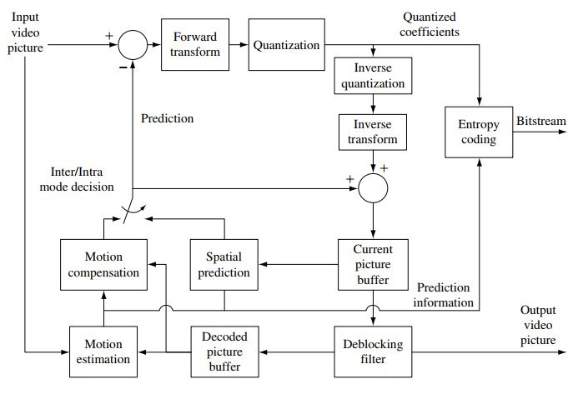
H.264 architecture

Slide 5
Frame encoding. Slices
A frame is divided into slices (a group of macroblocks, not necessary consecutive) which are independently encoded and decoded
If prev. standards had I/P/B frames, H.264 has I/P/B slices and the slice type determines the prediction modes available to macroblocks from the slide
Arbitrary slice order (ASO) in the compressed bitstream
Synchronization slice (SI for intracoding and SP for intercoding) – a type of slice that enables efficient switching between streams or between different parts of the same stream

Slide 6
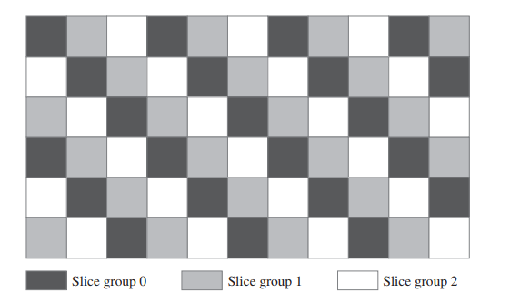
Slices. Flexible Macroblock Ordering (FMO)
Picture is divided into slice groups and a slice contains a group of macroblocks.
Macroblocks are allocated to slice groups according to a map (see fig.)
A slice contains the macroblocks in raster-scan order from a slice group
Corrupted macroblocks
can be reconstructed
from macroblocks from
the same slice

Slide 7
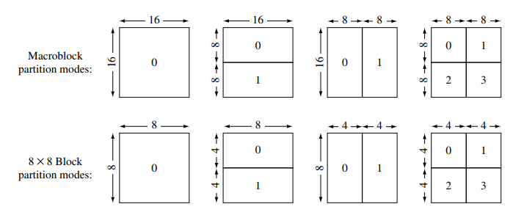
Macroblock encoding
a macroblock is partitioned into blocks in several ways (see fig.)
max. 32 motion vectors can be used for 1 macroblock (if the MB is partitioned into 16 4x4 blocks)
a MB can be predicted from max 32 frames (not just from 2 frames as for prev. standard B-frames) – flexible multiple reference picture buffer
Quarter-pixel accuracy
for motion estimation

Slide 8
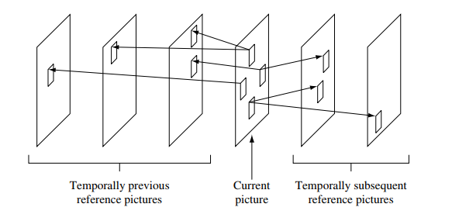
Multireference macroblock prediction

Slide 9
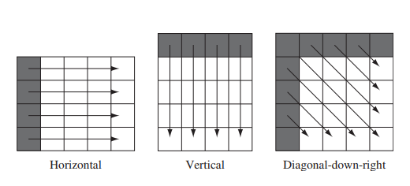
Macroblock encoding
Quarter-pixel accuracy for motion estimation - Luma component predictions at half-sample locations are interpolated using a 6-tap FIR filter; predictions at quarter-sample locations are computed through a bilinear interpolation of the values for two neighbouring integer or half-sample locations.
A MB can be encoded as a weighted average of other MBs from different frames
Intraprediction modes (predicting pixel values inside a frame from neighbor samples):

Slide 10
Deblocking filter
A filter used for smoothing block based video encoding
In block-based encoding artifacts are obtained at the edges of the block
The filter operates on a 4x4 grid on luma and chrominance components
The filter is adaptive in order to eliminate encoding artifacts, but not produce excessive smoothing : it checks the quantization factor that is used on both sides of an edge – if it is similar, the artifact is caused artificially and a stronger deblock filter is used, if the quantization factors differ significantly then the artifact is natural due to the edge and a finer filter is used

Slide 11
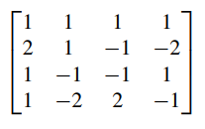
Discrete Cosine Transform
H.264 performs DCT on 8x8 or 4x4 blocks
H.264 uses a highly efficient integer approximation to the floating-point DCT:
Let f be a 4x4 input block
Let F be the output FDCT&quantisized 4x4 block
$F= {(C}_{}∙f∙C_{}^{T})∗S$
where ‘∙’ is the normal matrix multiplication
and ‘*’ is the Hadamard/Schur product (P=Q*R where p_{ij}=q_{ij}*r_{ij})
C is the core DCT transform matrix and S is the scaling+quantization matrix
C = S =

Slide 12
Entropy coding
Context-Adaptive Variable-Length Coding (CAVLC) – simpler, one probability model is used based on previously encoded macroblocks
Context-Adaptive Binary Arithmetic Coding (CABAC) – more complex, several probability models are used

Slide 13
The VP9 Codec

Slide 14
About VP9
VP9 is a open and royalty-free video coding standard developed by Google
Used a lot on youtube
Was extended to AV1 in 2018 by Alliance for Open Media (Google, Facebook, Amazon, IBM, Intel, Microsoft …)

Slide 15
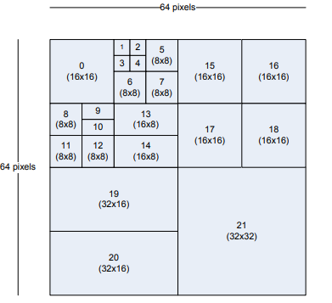
Macroblocks
Allows macroblocks of various sizes from 16x16 to 64x64
A macroblock can be partitioned in many blocks of different sizes (recoursively, depending on color variation in a block):

Slide 16
Block prediction
blocks are either inter predicted or intrapredicted
interpredicted blocks : blocks can be predicted from one or two blocks from a different frame or two different frames (if the current block is predicted from 2 blocks from different frames, the pixel values are averaged between the 2 blocks)
Intrapredicted blocks : pixels of a block can be predicted from other pixels from the same block (usually, the top-left, top-right, bottom-left, bottom-right pixels).
Only the difference between the actual block and the predicted block is passed further to DCT and quantization

Slide 17
DCT
Applies DCT on different block sizes: 8x8, 16x16, 32x32
It also introduced an ADST (Asymmetric Discrete Sine Transform)
DCT and ADST are applied on a row or on a column (on one dimension)

Slide 18
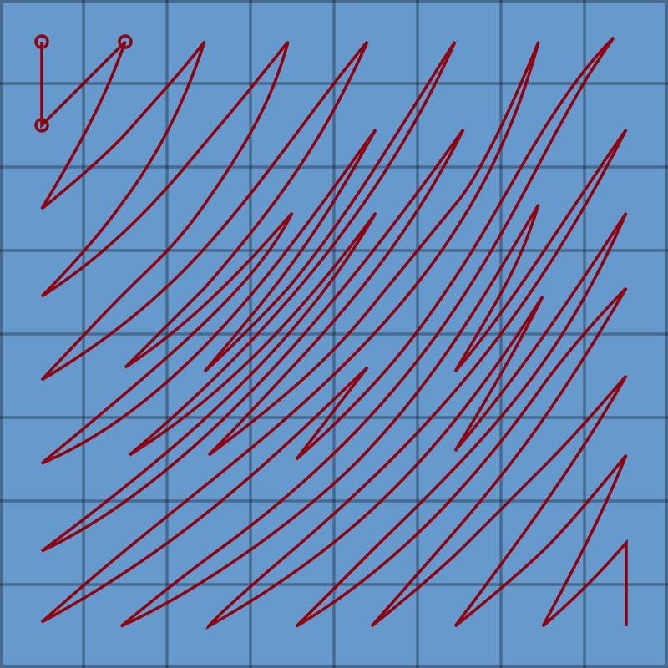
Zig-zag parsing
Special zig-zag order

Slide 19
H.265 – High efficiency video codec

Slide 20
About H.265 HEVC
finalized in 2013 (1st version), developed jointly by ITU.T VCEG group and ISO/IEC MPEG group
the MPEG name : MPEG-H Part 2
the ITU.T name : H.265
the compression efficiency is twice the efficiency of H.264 at the same resolution and video quality
the goals of H.265:
Higher resolution (4K, 8K)
Better compression
Support for parallel processing architecture (multi-core, multi-cpu)
Support for stereo and multiview capture

Slide 21
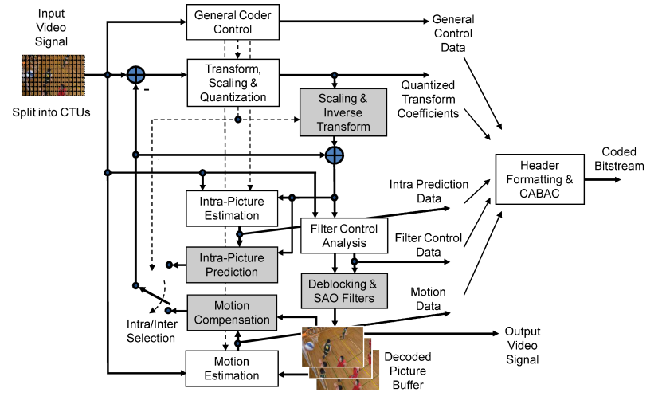
The HEVC encoder design
G. Sullivan, J.-R. Ohm, W.-J. Han, T. Wiegand, Overview of the High Efficiency Video Coding (HEVC) Standard, TCSVT, vol. 22, no. 12, pp. 1649, 2012

Slide 22
HEVC main lines
uses classical block-shaped region encoding, blocks ranging from 64x64 to 4x4
uses both inter-frame prediction (with motion vectors and motion compensation) and intra-frame prediction(i.e. pixels from the frame are predicted from other pixels from the same frame)
instead of I/P/B frames, HEVC has I/P/B slices (slice=set of consecutive CTUs)
instead of a 16x16 macroblock, HEVC uses CTU (Coding tree unit) which is made by 1 luma CTB (Coding tree block) and 2 chroma CTBs; a CTB is further splited into CB (coding block); 1 luma CB and 2 chroma CBs form a CU (Coding Unit)
the decision of intra-frame prediction or inter-frame prediction is taken at the CU level
Uses YCbCr colorspace with 4:2:0 subsampling for all processing

Slide 23
CTU, CTB, CB
a frame is partitioned into CTUs (Coding Tree Unit)
one CTU contains 1 luma CTB and 2 chroma CTBs
a luma CTB can be 64x64, 32x32, 16x16 pixels and a chroma CTB can be 32x32, 16x16, 8x8 pixels
a luma/chroma CTB can be used directly as a CB (Coding Block) end encoded or it can be further partitioned into multiple CBs
the minimum size for a luma CB is 8x8 and for a chroma CB is 4x4
the CTU spliting process has a quadtree structure and the splitting is applied recursively until we reached the desired size of a CB or the minimum allowed size of a CB
similarly, a CU (Coding Unit) is 1 luma CB and 2 chroma CBs

Slide 24
PBs (Prediction Blocks) and TBs (Transform Blocks)
CTBs are first decomposed into a prediction quad-tree and the depth of the quad-tree goes from 64x64 to 4x4 pixels or the decoder can stop it at an intermediary depth; any node in the quad-tree has 4 children, except the leaf nodes (e.g. a 64x64 root quad-tree is first decomposed into 4 32x32 PBs)
each leaf node in the quad-tree prediction is called a PB and it is encoded as either intra-predicted or inter-predicted, as residual error between the actual block and another one that predicts the actual block
after the prediction quad-tree is computed and residual error is computed for all the pixels in a CTB, the CTB is further decomposed in another quad-tree, called the transform quad-tree

Slide 25
PBs (Prediction Blocks) and TBs (Transform Blocks)
the transform quad-tree is computed in the same way as the prediction quad-tree (the leaf elements are now called TB) and the DCT transform is applied to each leaf node of the tree (i.e. to each TB)
If the TB is 4x4 pixels, DST (Discrete Sine Transform) is applied
by separating the prediction tree from the transform tree we can have a TB that is part of two separate PBs

Slide 26
Prediction Blocks and Transform Blocks decomposition
In the following figure we can see a prediction quad-tree or a transform quad tree decomposition:

Slide 27
Intra-prediction and inter-prediction
for intra-prediction HEVC has 35 prediction angles/directions while H.264 has only 9 for predicting pixels from neighboring samples
quarter-pixel resolution is used for inter-prediction
instead of I/P/B frames, we now have I/P/B slides
many inter-prediction partitioning modes of a CB:
symmetric modes: PART-2N×2N (CB is not split), PART-2N×N (CB is split into two equal-size PBs horizontally), PART-N×2N (CB is split into two equal-size PBs vertically), PART-N×N (CB is split into 4 equal size PBs)
asymmetric partition modes: PART-2N×nU, PART-2N×nD, PART-nL×2N, and PART-nR×2N

Slide 28
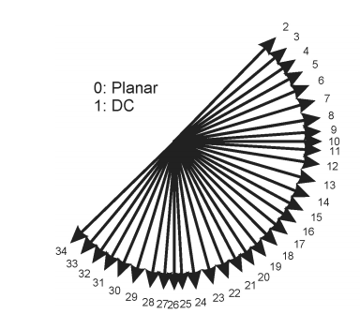
Intra-prediction modes
Pixels in a block are predicted from other pixels from the same slice/frame.

Slide 29
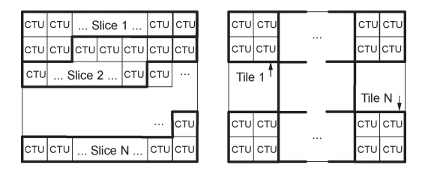
Slices and tiles
a picture is divided into slides (composed from slides segments) or tiles (composed from tiles segments)

Slide 30
Transform and quantization
DCT is applied on TBs of sizes 32x32, 16x16, 8x8 and 4x4
DST (Discrete Sine Transform) is applied on 4x4 TBs
H.265 HEVC used matrixes of coefficients with integer approximations for the cosine and sine functions in the DCT and DST formulas
quantization matrixes of 4x4 or 8x8 based on a Quantization Parameter (having values between 0 and 51) are used
after quantization, a deblocking filter is applied just like in H.264 AVC

Slide 31
Entropy encoding
for entropy encoding, CABAC is used similar to the way is specified in H.264 AVC, with minor modifications.

Slide 32
NAL (Network Access Layer) Units
the Bitstream includes first global parameters (VPS,SPS,PPS etc.) and then a list of NAL units
a NAL unit is an encoded frame/picture
reading a NAL unit from the bitstream is described in the Annex B of the standard
the syntax and semantics of the NAL Unit contents is described in section 7.3 of the standard
decoding a NAL Unit is described in section 8.2
decoding a slice from a NAL unit is described in section 8.3 of the standard

Slide 33
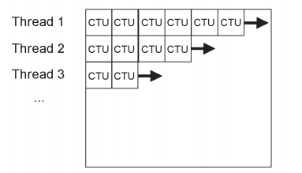
Wavefront parallel processing

